Slide 1

WINE QUALITY PREDICTION

Slide 2

TABLE OF CONTEXT
INTRODUCTION 03
WHY WINE QUALITY PREDICTION 04
KEY FEATURES 05
QUICK GLANCE AT OUR CODE 06-07
RESULT ANALYSIS 08
REFERENCES 09
CONCLUSION 10

Slide 3
INTRODUCTION
Wine is not just a beverage; it embodies centuries of tradition, culture, and craftsmanship. The quality of wine is a reflection of a delicate balance between nature and human intervention, influenced by a myriad of factors including grape variety, terroir, and winemaking techniques. For winemakers, understanding and predicting wine quality is essential for maintaining high standards and meeting consumer expectations. Similarly, for consumers, the ability to discern quality wines from the vast array of choices available is valuable in ensuring a satisfying tasting experience.
This project aims to leverage AI and ML algorithms to develop a predictive model for wine quality assessment. By analyzing a dataset containing various physicochemical properties of wines, including acidity levels, alcohol content, and volatile acidity, among others, we seek to uncover patterns and relationships that contribute to overall quality. Through rigorous data preprocessing, feature engineering, and model training, we aim to create a robust predictive framework capable of accurately estimating wine quality.

Slide 4
WHY WINE QUALTIY PREDICTION
This objective aims to provide an objective measure of wine quality that help stakeholder differentiate between wines that meet high quality standards and those who fall below expectations.
Nowadays, industries are using product quality certifications to promote their products. This is a time taking process and requires the assessment given by human experts which makes this process very expensive. This paper explores the usage of machine learning techniques such as logistic regression and support vector machine for product quality in two ways.

Slide 5
KEY FEATURES
Wine certification and quality assessment is physicochemical tests which are laboratory based and takes into account factors like:
1.Chemical Composition
2. Quality
3. pH level
4. Acidity
5. Density

Slide 6
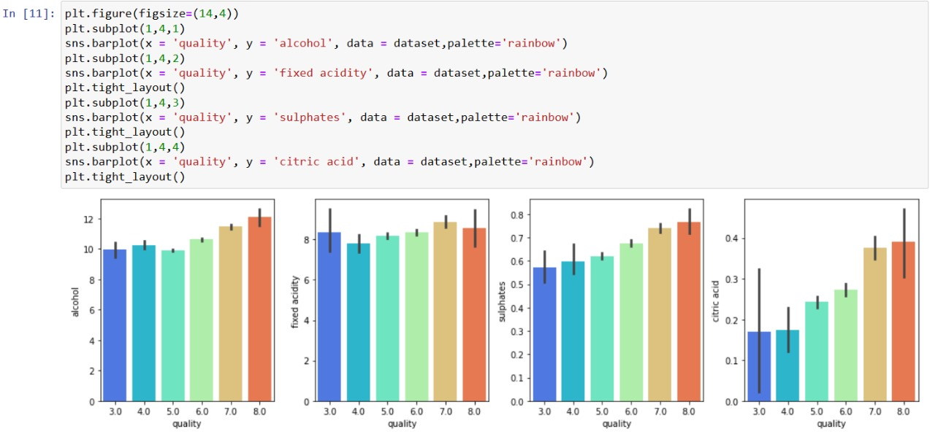
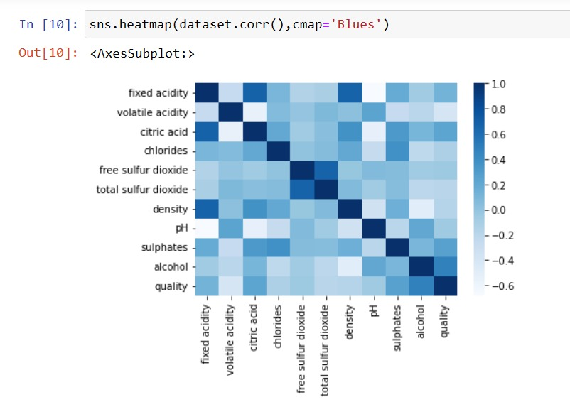
QUICK GLANCE AT OUR CODE
Fig(1):Showcasing comparison of quality with alcohol, fixed acidity, sulphates and citric acid.
Fig(2): Heatmap showcasing correlation between different variables in the dataset.

Slide 7
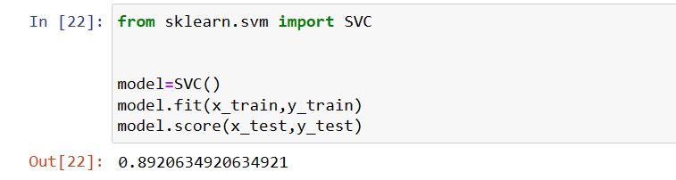
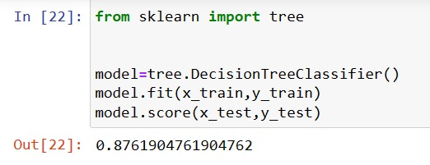
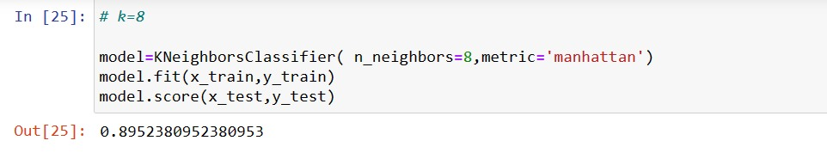
Fig(4): Finding accuracy score through decision tree classifier
Fig(3):Finding accuracy score through SVC(support vector classifier)
Fig(5): Finding accuracy score through KNN.

Slide 8
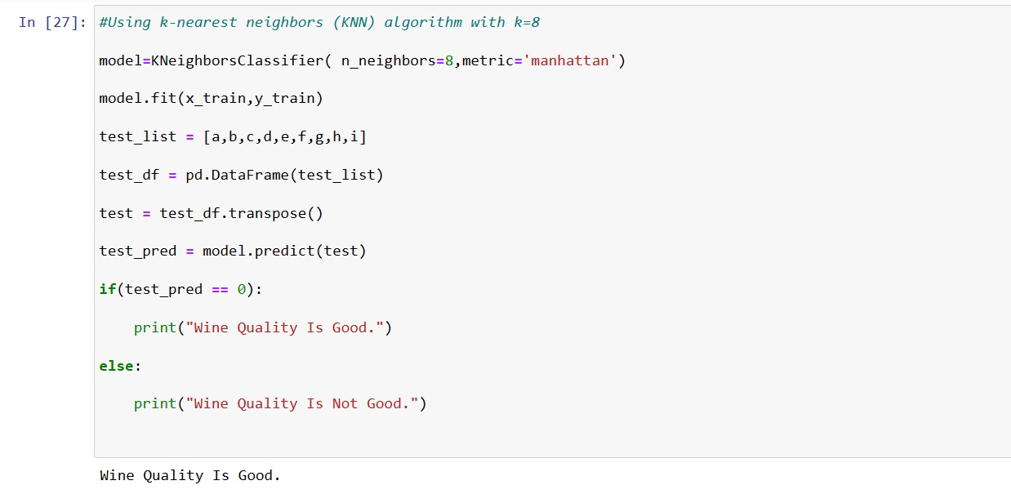
RESULT ANALYSIS
Fig(6): Predicts the quality of wine based on the input values provided by the user

Slide 9
REFERENCES
DATASET --→ https://github.com/Yashmenaria1/WineQualityPrediction/blob/main/wine_quality.csv
GOOGLE -→ https://www.google.com/
Geeks for Geeks -→ https://www.geeksforgeeks.org/

Slide 10
CONCLUSION
Skills development
Data analysis insight
Algorithms exploration
Problem solving

Slide 11


